Slide 1




FINAL PRESENTATION
G1
LIU Yang
Petal Ketul
GUO Xiaofan
ISAH John Itopa
KOVAYCIN Umut
ELECTRONIQUE & SIGNAL
Final Presentation
25/01/2024

Slide 2

OVERVIEW
UKXY3000
UKXY3000 transforms air travel with real-time Bluetooth monitoring, ensuring passenger engagement and safety alerts for swift responses. The project introduces cutting-edge features like active noise cancellation, precise temperature control, and optimal air quality, creating a quieter and more comfortable in-flight experience.

Slide 3
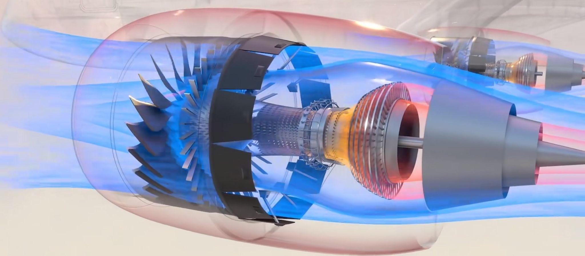
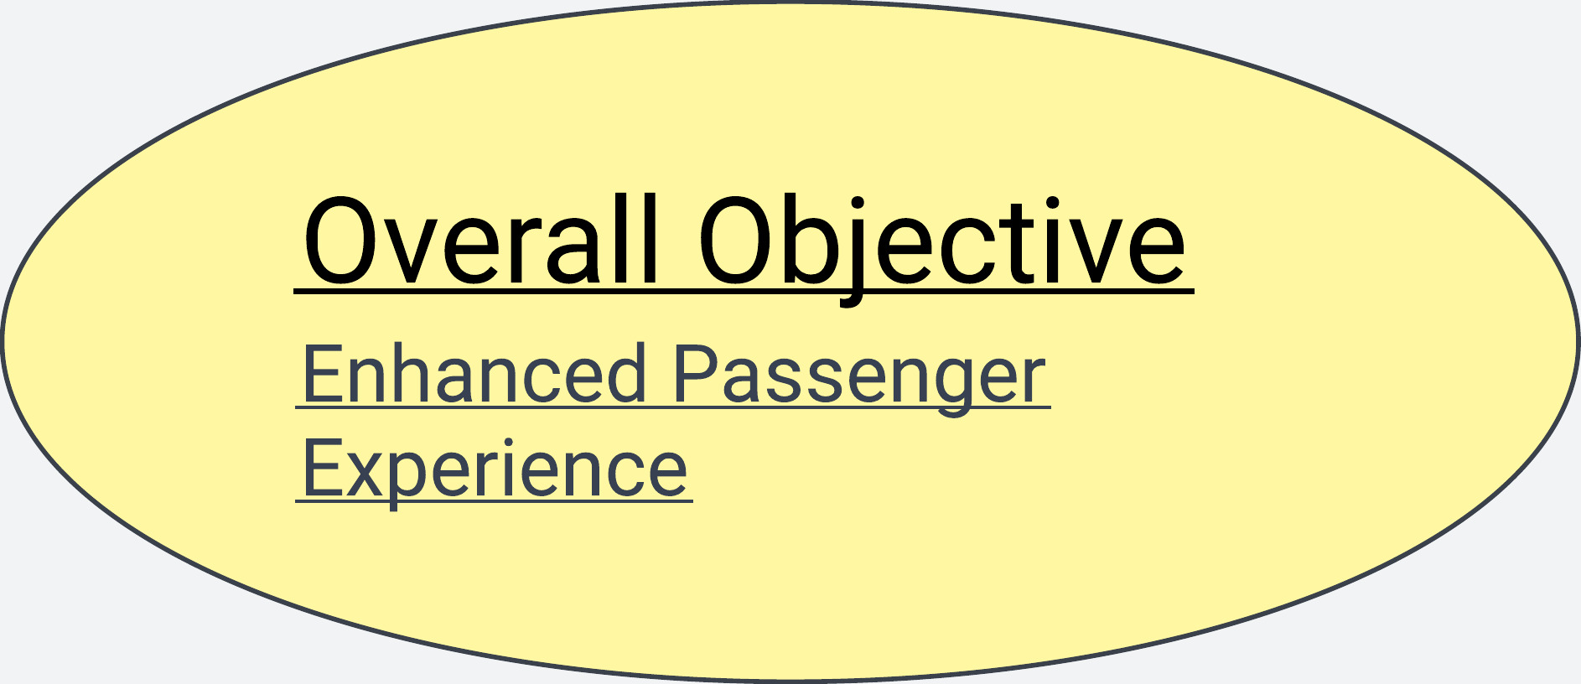
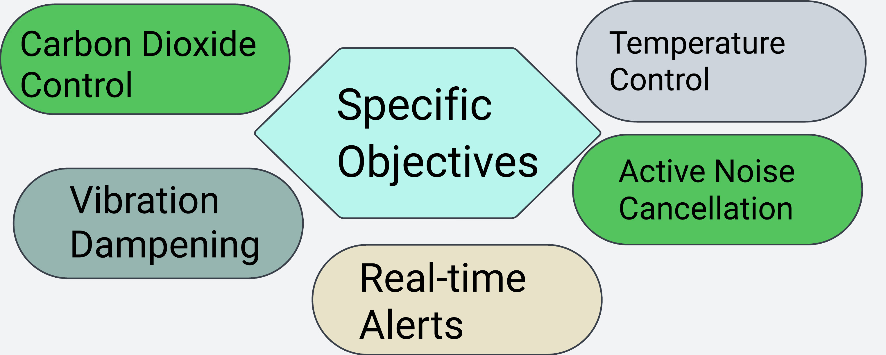
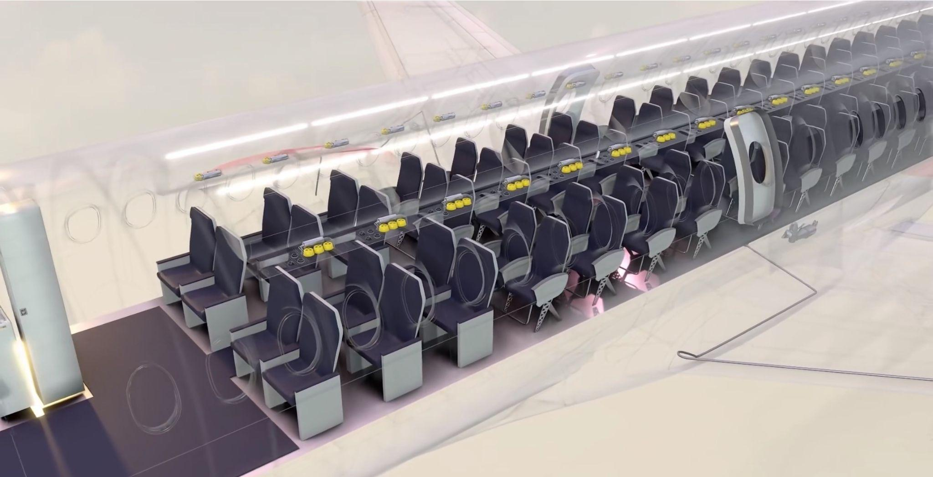
PROJECT OBJECTIVES
3

Slide 4

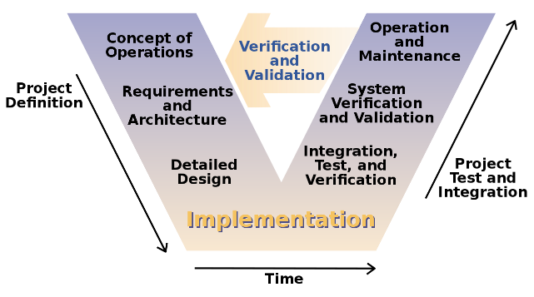
MISSION 1

Slide 5
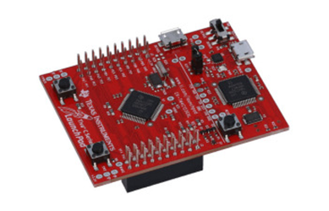
Project Implementation
Implementation
Electronic Assembly:
Assemble and integrate project electronics, focusing on the microcontroller core
Hardware Components:
Utilized Tiva Microcontroller – ARM® Cortex®-M4F Based MCU TM4C123G Launchpad
Integrate Temperature and Humidity Sensor.
Incorporate Ultrasonic Sensor
Include Main board, display board, and amplifier board
Software Utilization:
Employ Energia IDE for microcontroller programing using C language.
Leverage Energia IDE to display environmental parameters obtained from integrated sensors
Electronics Assembly:
Integrated Tiva Microcontroller (ARM® Cortex®-M4F Based MCU TM4C123G Launchpad).
Assembled temperature and humidity sensors, ultrasonic sensor, main board, display board, and amplifier board.
Software Development:
Programmed using Energia IDE and C language for microcontroller functionality.
Developed software to display and analyze environmental parameters obtained from sensors.
5

Slide 6
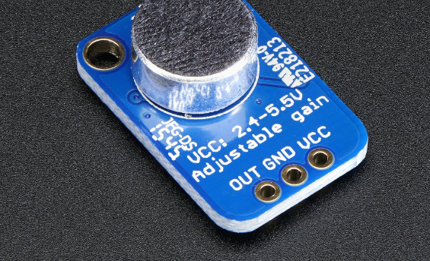
Sensors Integrated
LM35 (Temperature Sensor): Provides real-time temperature data for precise environmental monitoring within the aircraft compartment.
MiCS-VZ-98-TE (CO2 Sensor): Ensures optimal cabin air quality through continuous measurement of carbon dioxide levels.
AMB-707-RC (Microphone - Omni): Captures and analyzes environmental sound, distinguishing critical from non-critical sources.

Slide 7
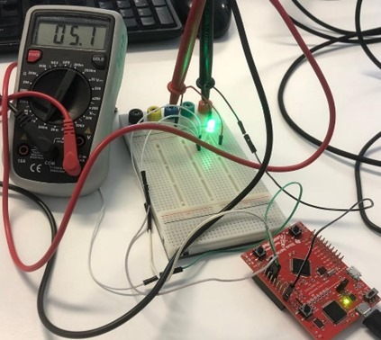
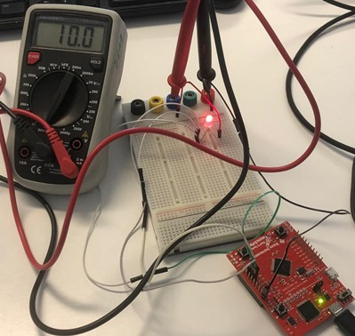
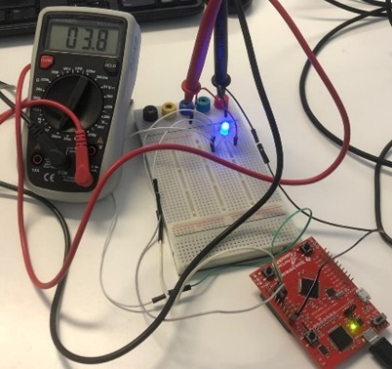
Measuring the LED

Slide 8
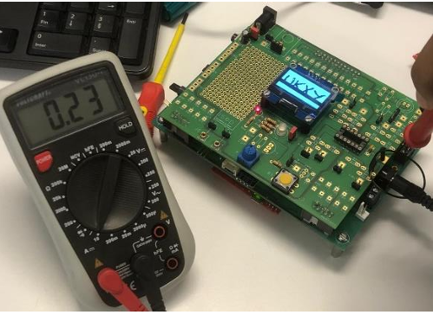
Power Consumption
Calculate Power:
P =0.23 𝑚𝐴×5𝑉 =0.00115
Calculate Total Energy Consumption:
E_{day} = 𝑃×24 ℎ𝑜𝑢𝑟𝑠 = 0.276 𝑊ℎ
Convert to Kilowatt-hours:
E_{day} = 0.0276𝑊ℎ ÷1000 = 0.0000276 𝑘𝑊ℎ
Calculate Carbon Equivalent
E_{day} = 𝐸𝑑𝑎𝑦 ×𝐶𝑎𝑟𝑏𝑜𝑛 𝐼𝑛𝑡𝑒𝑛𝑠𝑖𝑡𝑦
= 0.0000276𝑘𝑊ℎ × 0.35𝑘𝑔𝐶𝑂2𝑒 𝑘𝑊ℎ
= 0.00000966𝑘𝑔 𝐶𝑂2𝑒

Slide 9
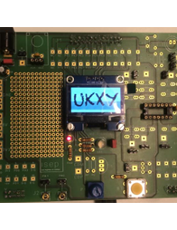
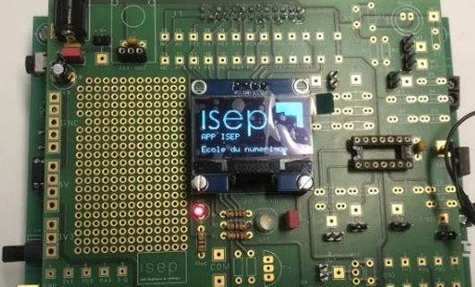
OLED DISPLAY

Slide 10
MISSION 2
Sensor connection
And
signal processing part

Slide 11
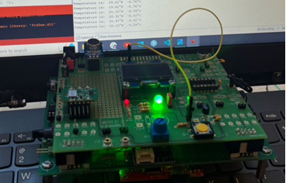
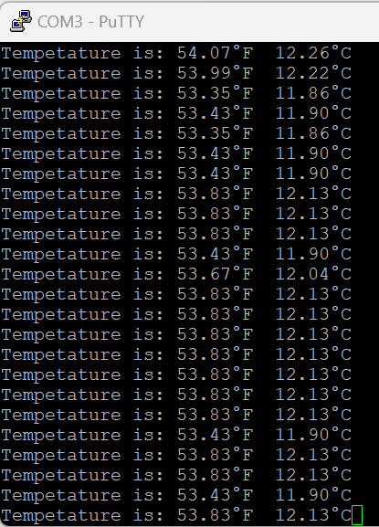
Temperature Display via Putty

Slide 12
System Operation
The device is triggered based on the power of an audio signal compared to the silence threshold.
It starts to listen for the key by passing the signal through a filter. If the key is detected by the filter, then the device begins measuring process.
It measures the sound quality in decibels
It measures and outputs the temperature and humidity of the environment.

Slide 13
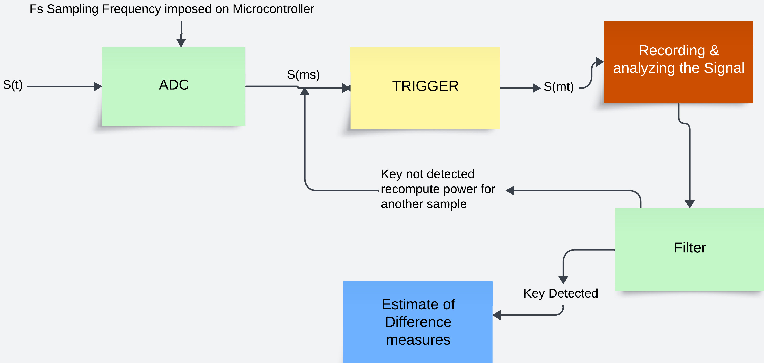
Voice Treatment

Slide 14
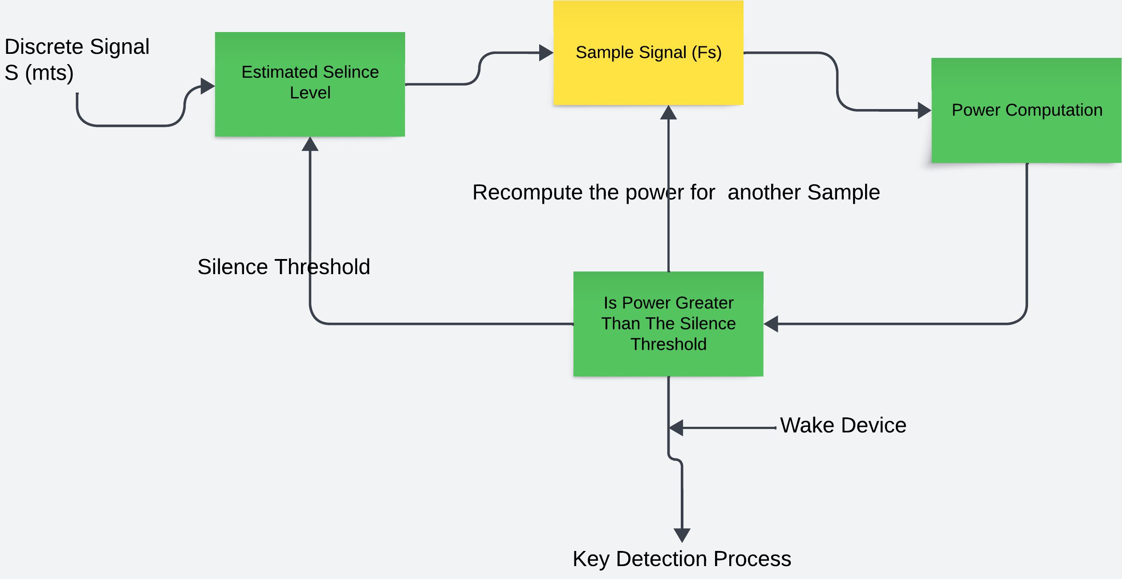
Trigger System

Slide 15
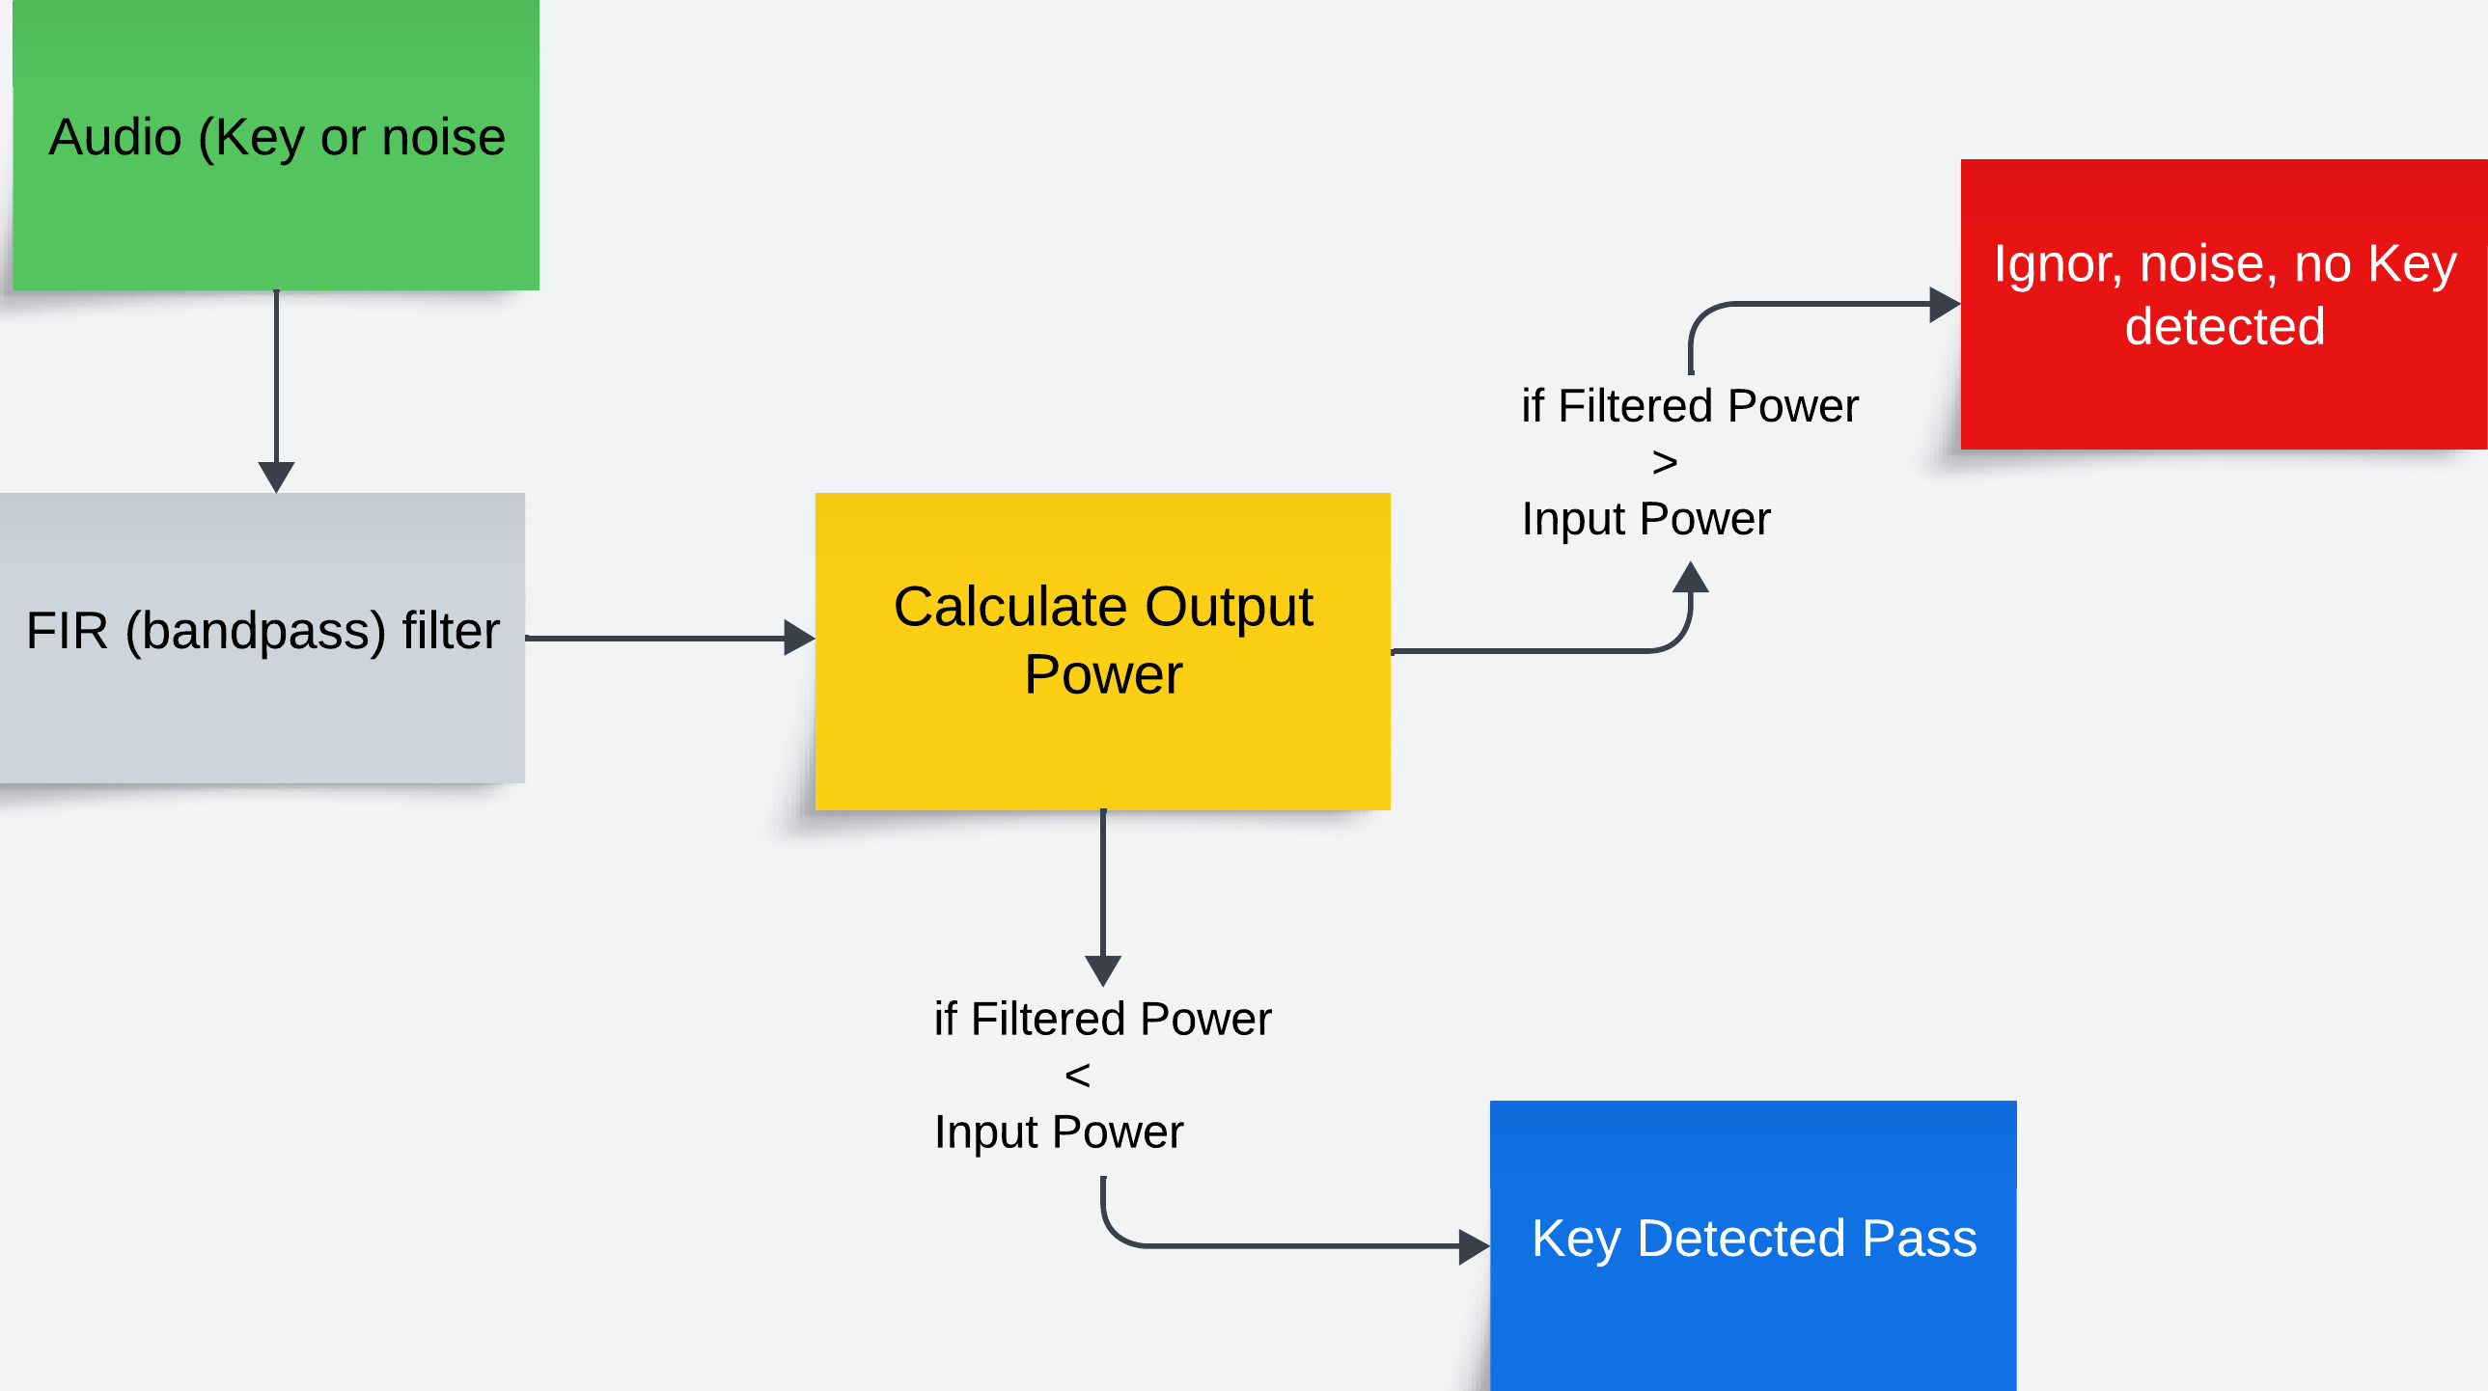
Filter Design and implemention

Slide 16
MISSION 3
Connection Between Hardware
&
Data Transmission

Slide 17
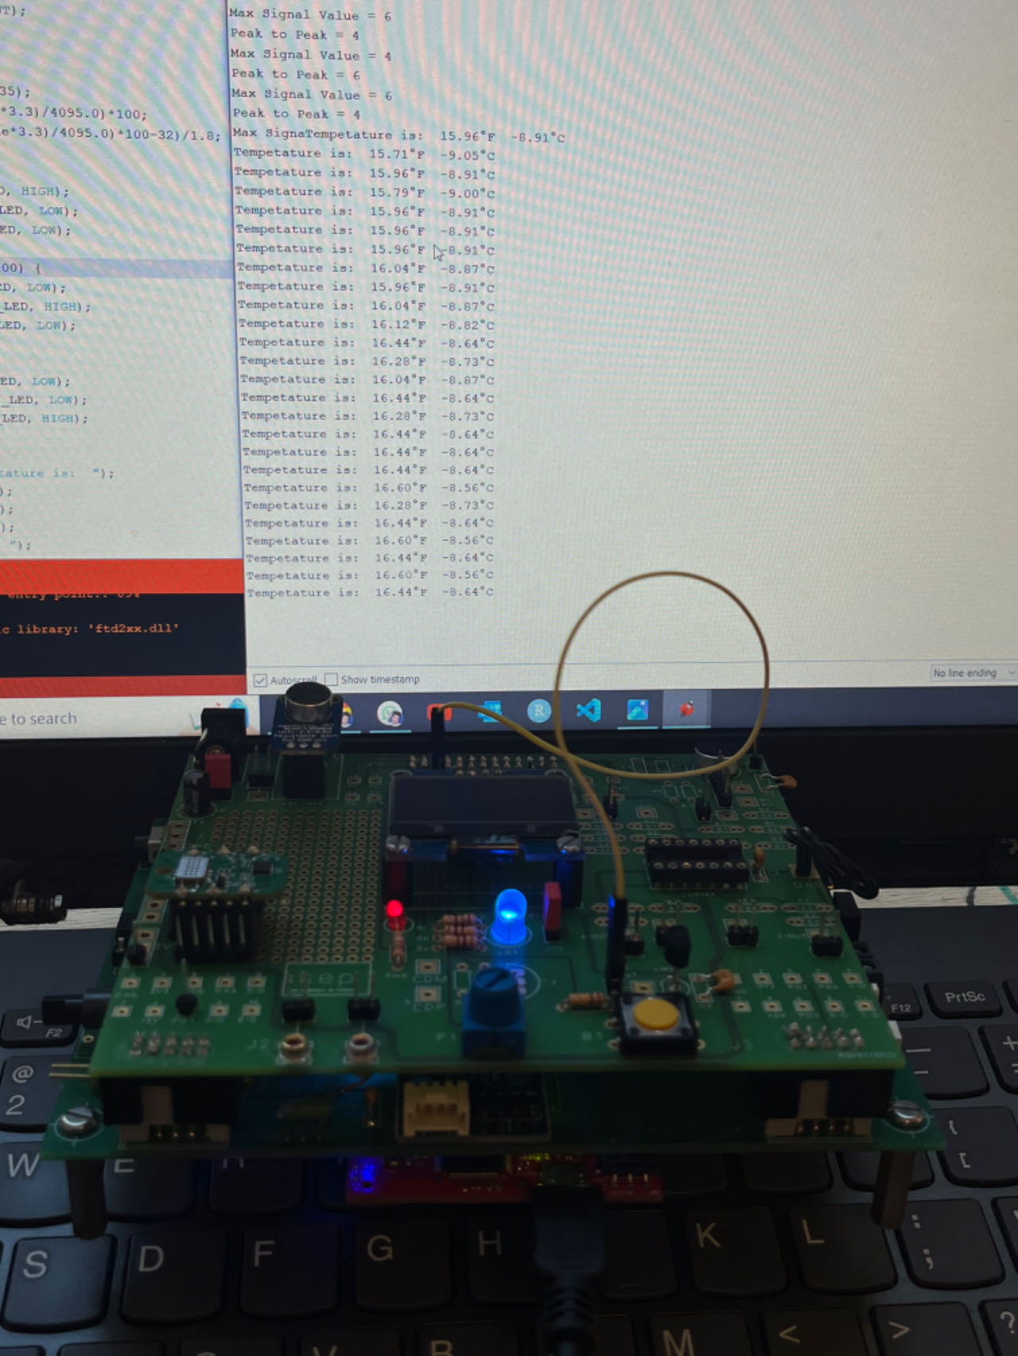
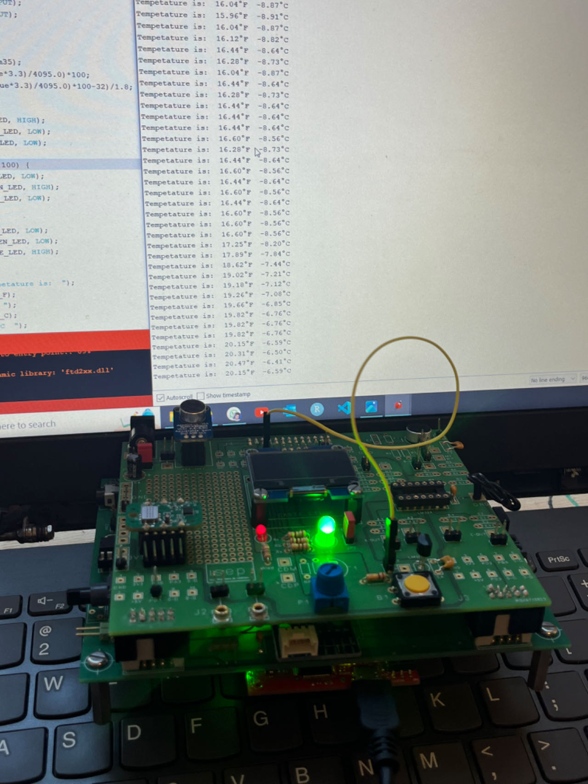
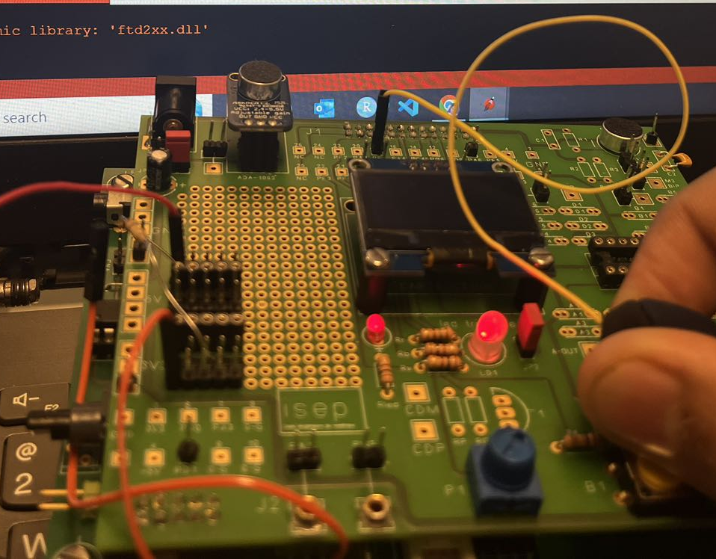
Link the temperature sensor and control its data to control the LED
Low temperature
Suitable temperature
High temperature

Slide 18
Link the micro sensor & CO2 sensor to control the LED
The micro sensor:
blue light: the environment is very quiet
green light: the environment is quiet
red light: the environment is noisy, administrators need to take necessary measures to mitigate the noise.
2. The CO2 sensor:
green light: the cabin air is fresh
blue light: the cabin air is good
red light: the cabin air is bad, administrators need to improve air circulation.

Slide 19

Data settings for actual application (in the cabin)
The temperature sensor:
Blue : below 16 degrees Celsius
green : 16~25 degrees Celsius
red : over 25 degrees Celsius
2. The micro sensor:
blue : below 70 dB
Green : 70~80 dB
red : over 80 dB
3. The CO2 sensor:
green : below 400 ppm
blue : 400~1000 ppm
red : over 1000 ppm

Slide 20
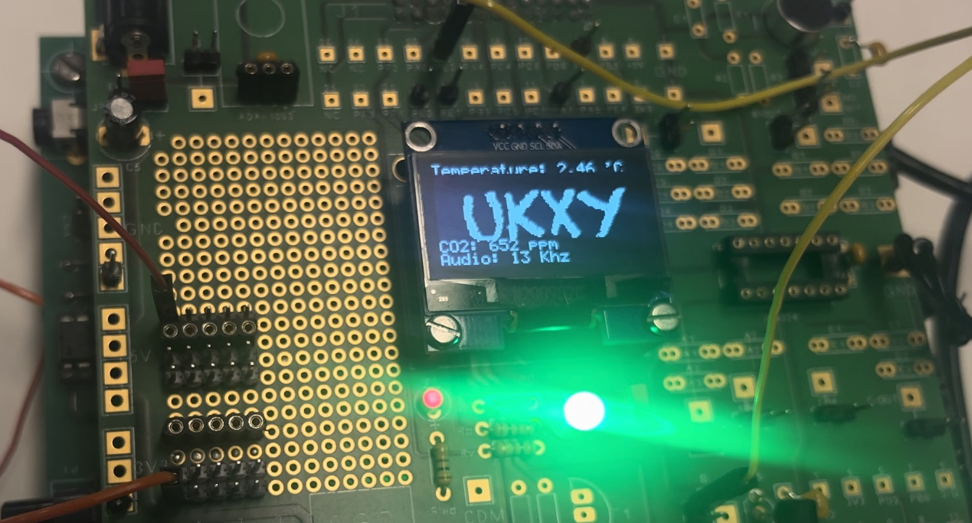
Connect the sensor to the screen and print relevant information to the screen

Slide 21
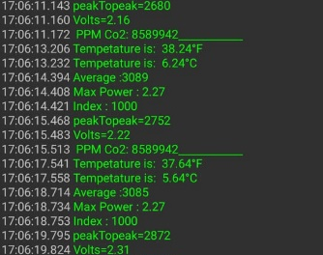
Real-time data transmission via Bluetooth
Information :
Real-time
Temperature
Average Voice Power
Max Voice Power
PPM CO2

Slide 22
Conclusion

Slide 23
Technology For Humanity
We work so that you can breathe in a healthier environment. If we are in your environment, you can trust the green light.
Even though we were in your environment, did you not see the light? Just check your phone we'll be there for you.
We monitor the temperature of the environment moment by moment. If we are in your environment, you can trust the green light.

Slide 24
Key points
Comprehensive Understanding
Software Proficiency
TIVA Platform Utilization
LED Indicator and Display Programming
MATLAB for Signal Processing
Visual Cues for environment data Check
Detailed Screen Display
Collaborative Effort

Slide 25
Thank You!

